Slide 1

Final Project Scientific Input and Output Analysis By: Chao Wang
Data downloaded from data.worldbank.org
https://data.worldbank.org/indicator/IP.JRN.ARTC.SC?end=2018&start=2000&view=chart
https://data.worldbank.org/indicator/SP.POP.SCIE.RD.P6
https://data.worldbank.org/indicator/GB.XPD.RSDV.GD.ZS?end=2018&start=2018&view=map&year=2010

Slide 2
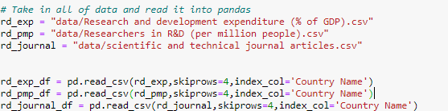
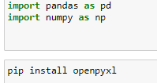
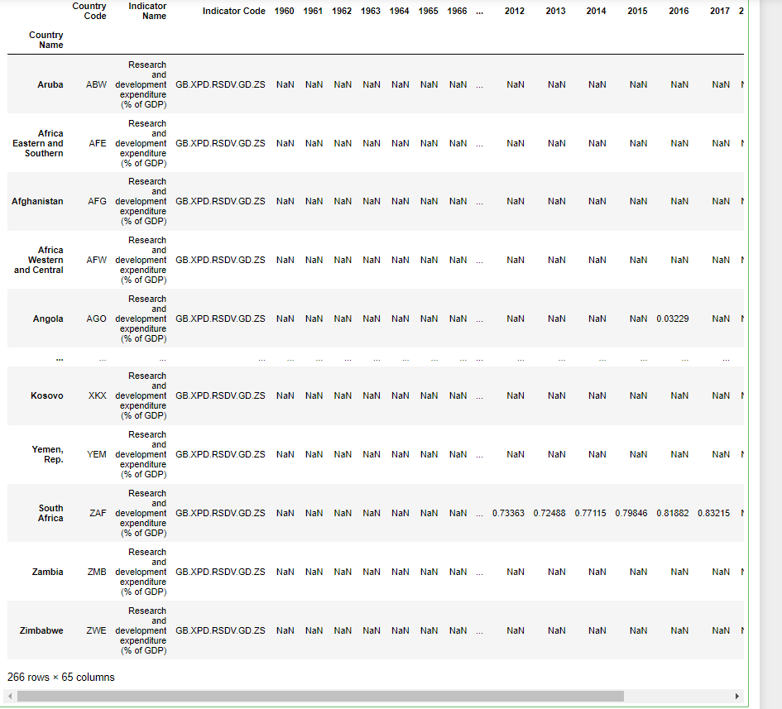
Data Cleaning
Pandas and numpy are used to drop nan value columns
Openpyxl is used to save as excel format

Slide 3

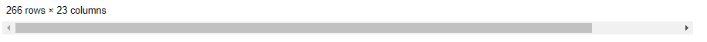
Data Cleaning

Slide 4
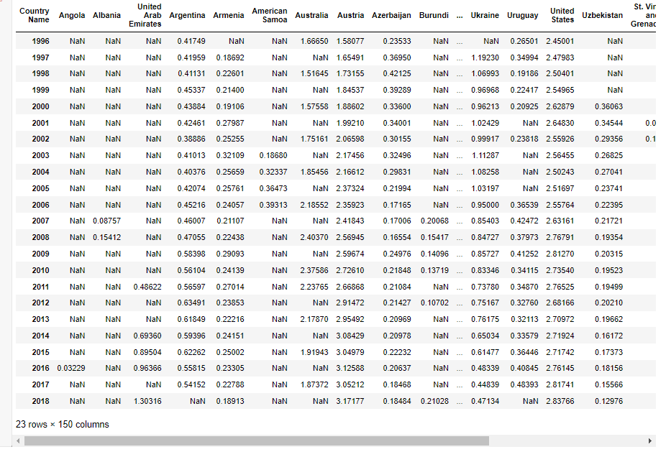
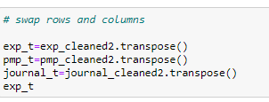

Data Cleaning

Slide 5
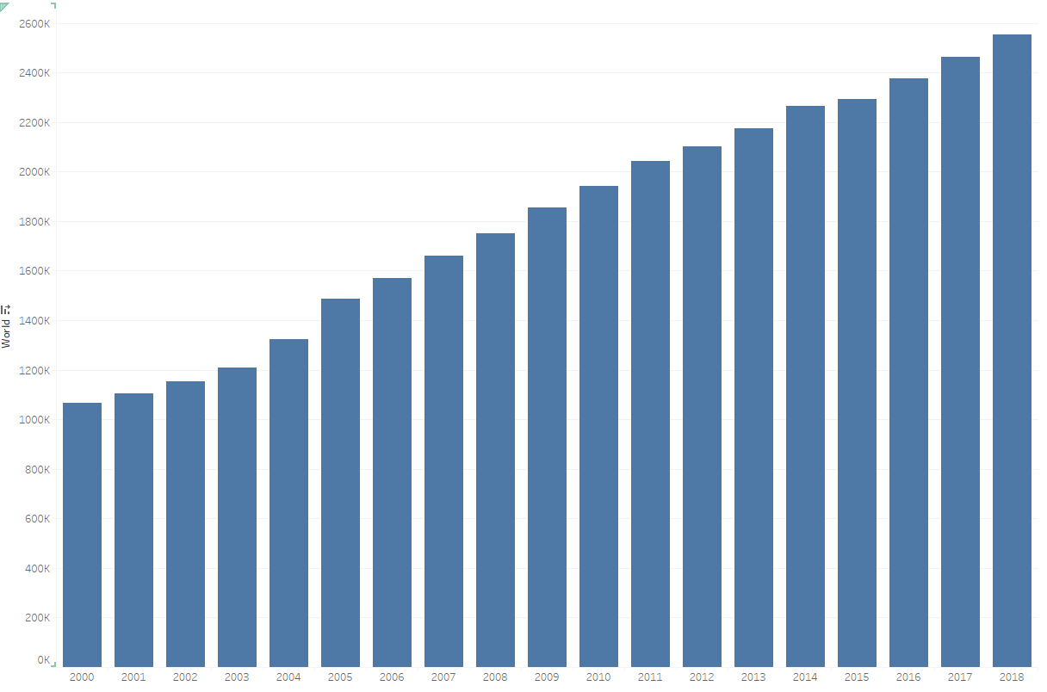
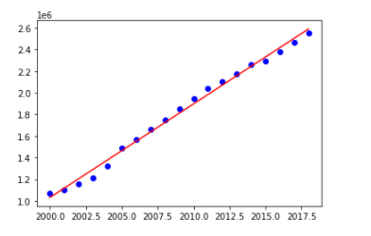
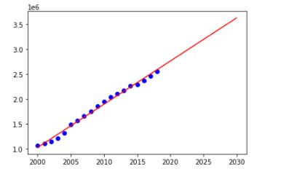
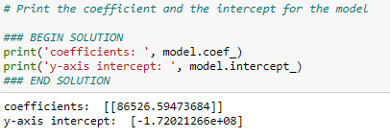

Machine learning
Linear Regression model
y=86526.594X-1.72x10⁸
In 2030 the number of publication :3,648,985.82

Slide 6
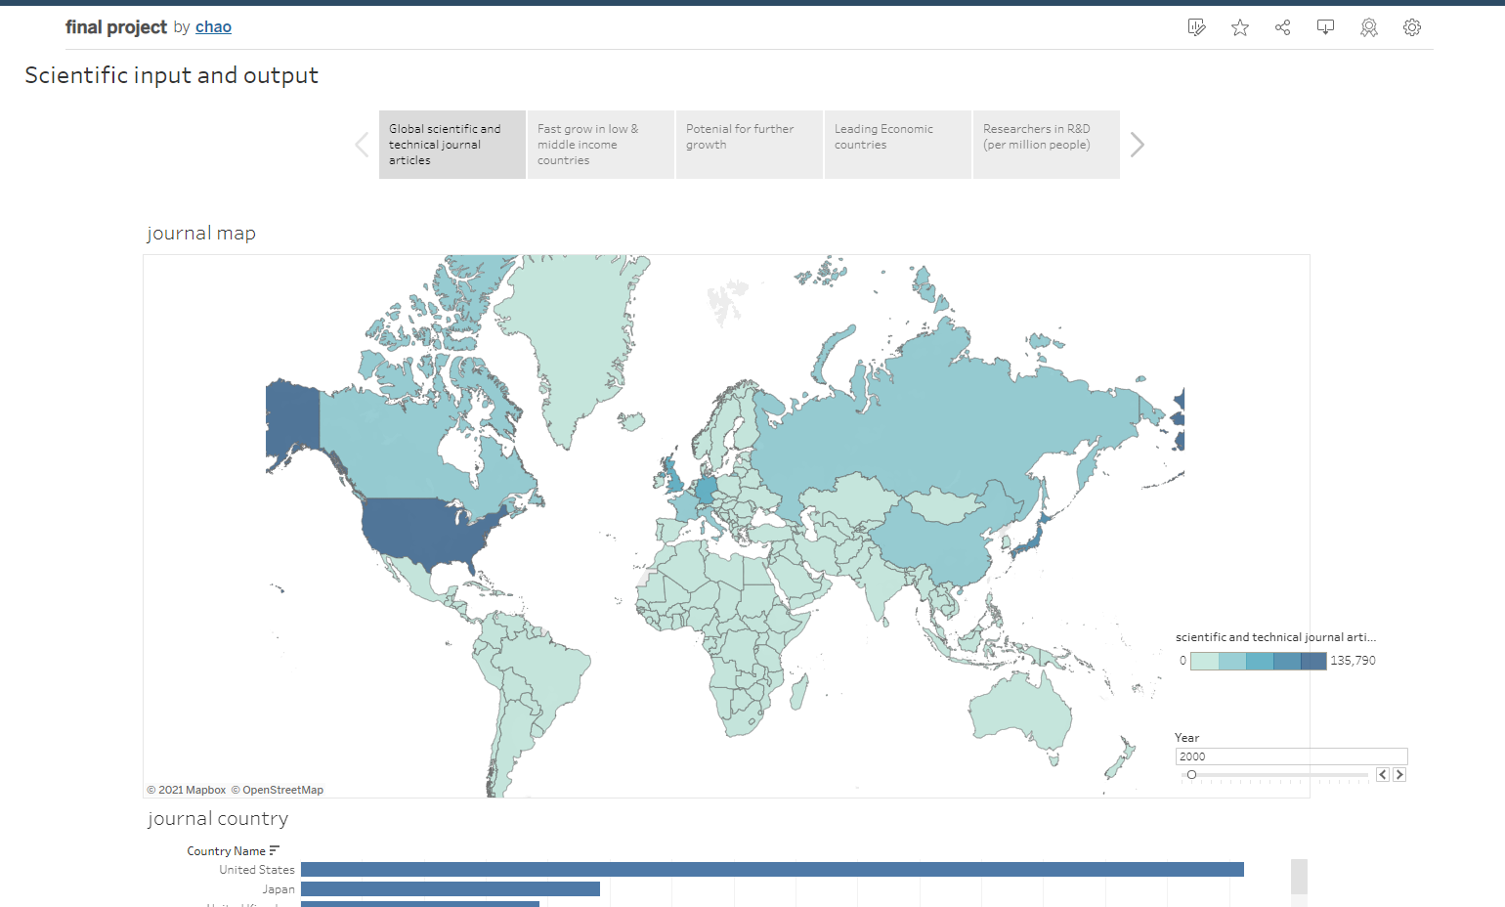
Tableau public
https://public.tableau.com/app/profile/chao7078/viz/finalproject_16343892167190/Story1
Tableau public is used for visualisation

